Slide 1

WINNING SPACE RACE WITH DATA SCIENCE
Name: Drenusha Gllavica
Date: 11.12.2022

Slide 2





I. EXECUTIVE SUMMARY
II. INTRODUCTION
OUTLINE
III. METHODOLOGY
IV. RESULTS
V. CONCLUSION

Slide 3
SUMMARY OF METHODOLOGIES
Data Collection through API and Web Scraping
Data Wrangling
Exploratory Data Analysis with SQL and Data Visualization
Interactive Visual Analytics with Folium
Machine Learning Prediction
EXECUTIVE OVERVIEW
SUMMARY OF ALL RESULTS
Exploratory Data Analysis result
Interactive analytics in screenshots
Predictive Analytics result

Slide 4
INTRODUCTION
PROJECT BACKGROUND AND CONTEXT
SpaceX advertises Falcon 9 rocket launches on its website, with a cost of 62 million dollars. Other providers cost upward of 165 million dollars each.
Much of the savings is because SpaceX can reuse the first stage. Therefore, if we can determine if the first stage will land, we can determine the cost of a launch.
KEY PROBLEMS TO FIND ANSWERS
What factors determine if the rocket will land successfully?
The interaction amongst various features on a rocket that lands successfully.
Determine if the first stage of Falcon 9 will land successfully.

Slide 5

SECTION 1 METHODOLOGY

Slide 6
DATA COLLECTION
We collected data on the Falcon 9 first-stage landings by using a RESTful API and web scraping from Wikipedia.
We gained information on launches, including information about the rocket used, payload delivered, launch specifications, landing specifications, and landing outcome.
Cleaning the data and transforming it from its raw form to a format that is ready to be analyzed.
Replacing missing values for the variable Payload Mass.
Filter data to include only Falcon 9 launches.
Link: https://github.com/drenushagllavica/IBM_Capstone/blob/4a40c3677a6a90e1896c37be6ae7a1410b483a9f/SpaceX_Data_collection_api.ipynb

Slide 7
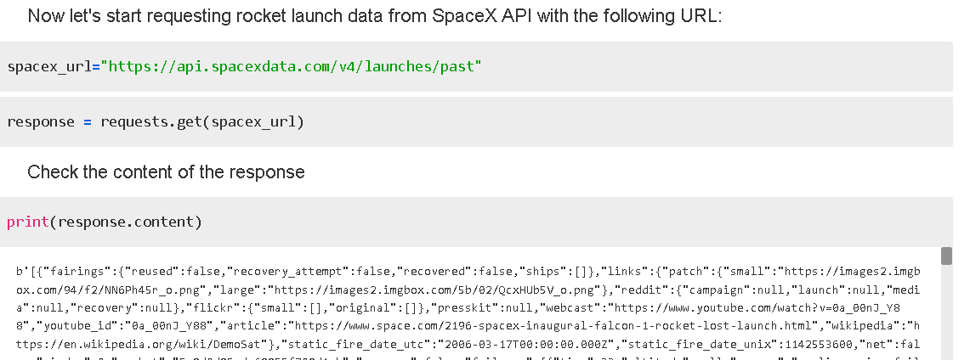
RESTful API

Slide 8
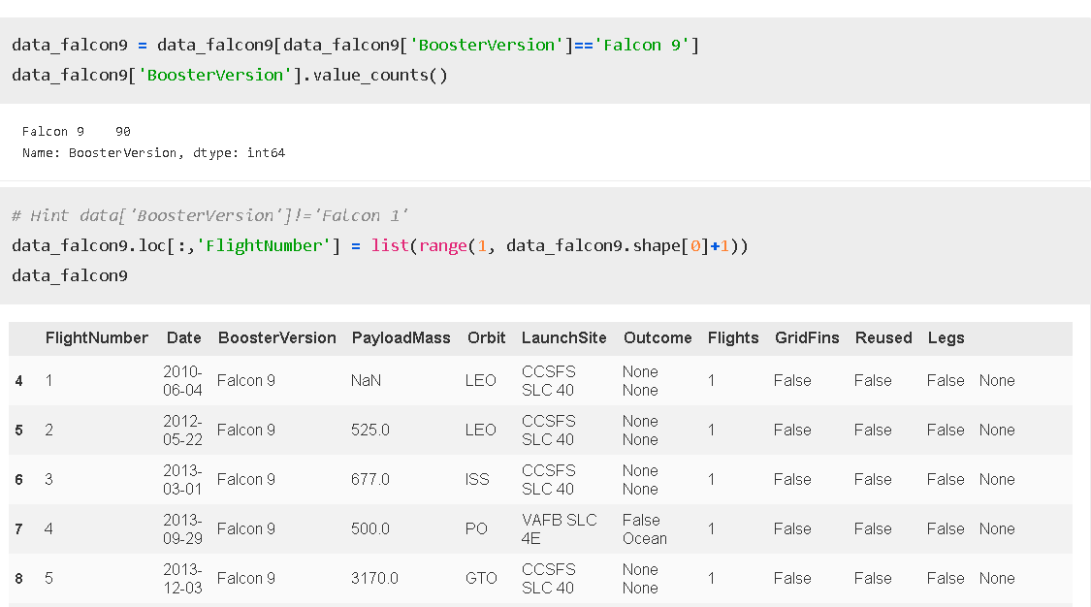
Filter data to only include Falcon 9 launches
RESTful API

Slide 9
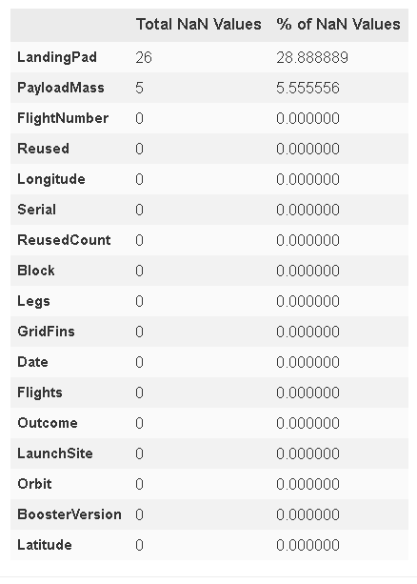
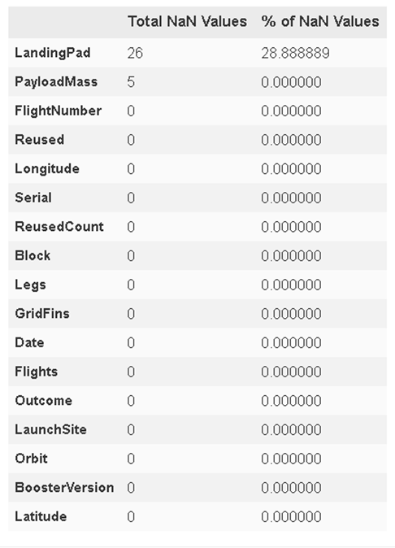
Replaced missing values for Payload Mass
RESTful API

Slide 10
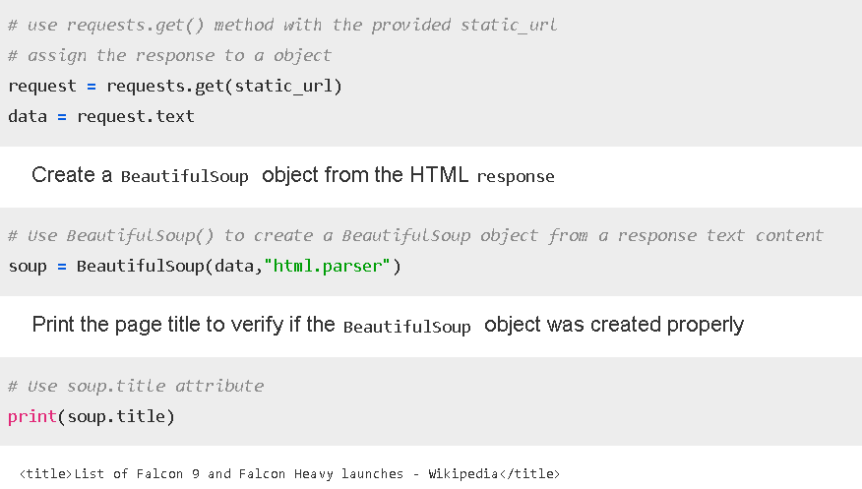
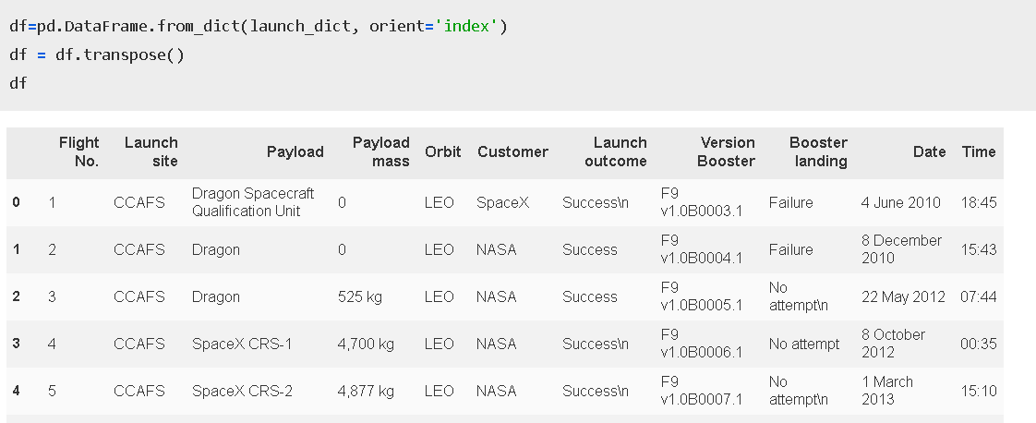
WEB SCRAPPING FROM WIKIPEDIA
Parsed table
Link: https://github.com/drenushagllavica/IBM_Capstone/blob/4a40c3677a6a90e1896c37be6ae7a1410b483a9f/SpaceX_webscraping.ipynb

Slide 11
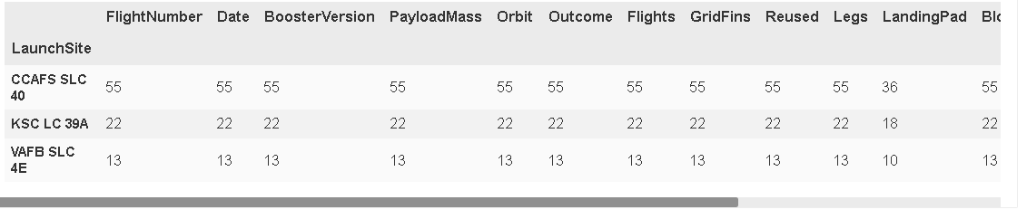
DATA WRANGLING
We performed exploratory data analysis and determined the training labels.
We calculated the number of launches at each site, and the number and occurrence of each orbits.
We created landing outcome label from outcome column and exported the results to csv.
Link: https://github.com/drenushagllavica/IBM_Capstone/blob/4a40c3677a6a90e1896c37be6ae7a1410b483a9f/SpaceX-Data%20wrangling.ipynb

Slide 12
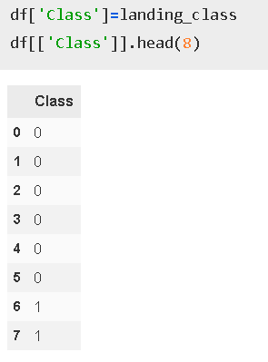
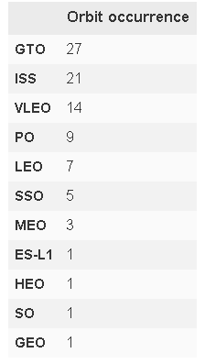
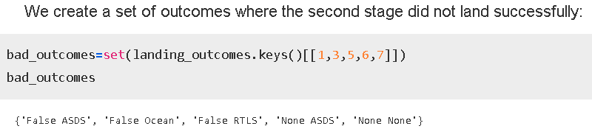
DATA WRANGLING

Slide 13
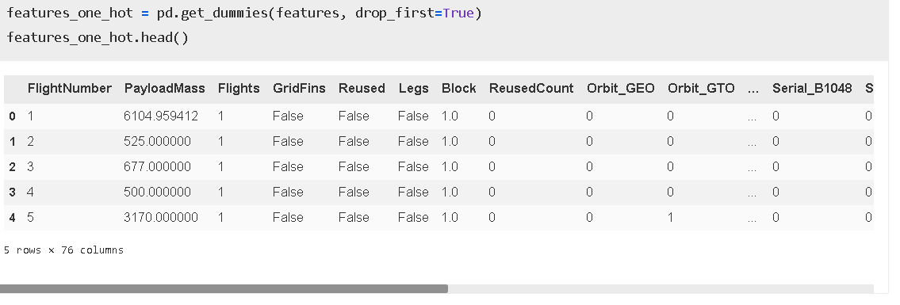
ONE HOT ENCODING

Slide 14
EDA with Data Visualization & SQL
Launch Site & Flight Number
Launch Site & Payload Mass
Orbit type & Class
Orbit type & Flight Number
Orbit type & Payload Mass
Success rate per year
The names of unique launch sites in the space mission.
The total payload mass carried by boosters launched by NASA (CRS)
The average payload mass carried by booster version F9 v1.1
The total number of successful and failure mission outcomes
The failed landing outcomes in drone ship, their booster version and launch site names.
Links:
https://github.com/drenushagllavica/IBM_Capstone/blob/4a40c3677a6a90e1896c37be6ae7a1410b483a9f/SpaceX_DataViz.ipynb
https://github.com/drenushagllavica/IBM_Capstone/blob/4a40c3677a6a90e1896c37be6ae7a1410b483a9f/SpaceX_EDA_SQL.ipynb

Slide 15
BUILD AN INTERACTIVE MAP WITH FOLIUM
Marked all launch sites on a map using site's latitude and longitude coordinates.
Started with an initial center location to be NASA Johnson Space Center at Houston, Texas.
Used folium.Circle and folium.Marker to mark all launch sites.
Marked the success/failed launches for each site on the map
If a launch was successful (class=1), then we use a green marker and if a launch was failed, we use ared marker (class=0)
Calculated the distances between a launch site to its proximities
- We added a MousePosition on the map to get coordinate for a mouse over a point on the map. As such, while we are exploring the map, we can easily find the coordinates of any points of interests.
Link:
https://github.com/drenushagllavica/IBM_Capstone/blob/4a40c3677a6a90e1896c37be6ae7a1410b483a9f/SpaceX_Folium.ipynb

Slide 16
BUILD A DASHBOARD WITH PLOTLY DASH
We builded a Plotly Dash application to perform interactive visual analytics on SpaceX launch data in real-time.
This dashboard application contains input components such as a dropdown list and a range slider to interact with a pie chart and a scatter point chart.
Insights we gained:
Which site has the largest successful launches?
Which site has the highest launch success rate?
Which payload range(s) has the highest launch success rate?
Which payload range(s) has the lowest launch success rate?
Which F9 Booster version (v1.0, v1.1, FT, B4, B5, etc.) has the highest launch success rate?
Link:
https://github.com/drenushagllavica/IBM_Capstone/blob/4a40c3677a6a90e1896c37be6ae7a1410b483a9f/SpaceX_dash.ipynb

Slide 17
MACHINE LEARNING PREDICTION
Perform exploratory Data Analysis and determine Training Labels
Create a column for the class
Standardize the data
Split into training data and test data
Find best Hyperparameter for SVM, Classification Trees and Logistic Regression
Find the method performs best using test data
Link:
https://github.com/drenushagllavica/IBM_Capstone/blob/4a40c3677a6a90e1896c37be6ae7a1410b483a9f/SpaceX_Machine%20Learning%20Prediction.ipynb

Slide 18
SECTION 2 RESULTS

Slide 19
EDA with Data Visualization & SQL

Slide 20
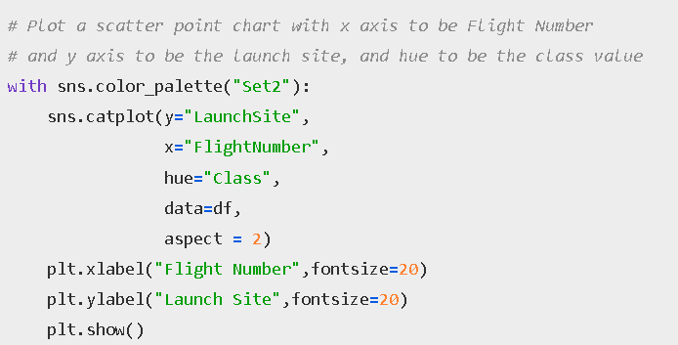
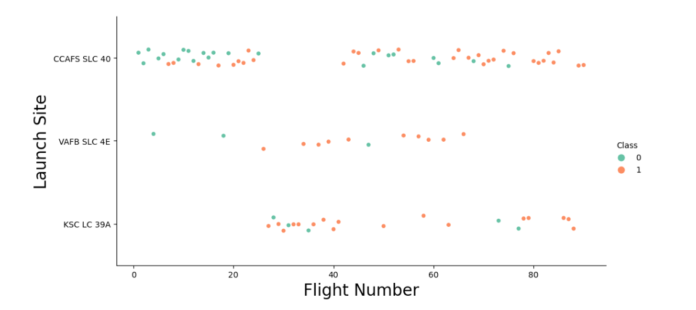
Launch Site & Flight Number
The higher the amount of launch attempts, the better is the success rate.

Slide 21
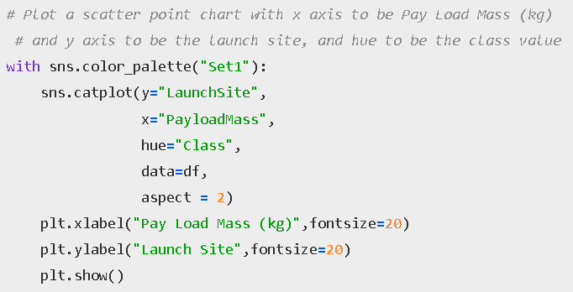
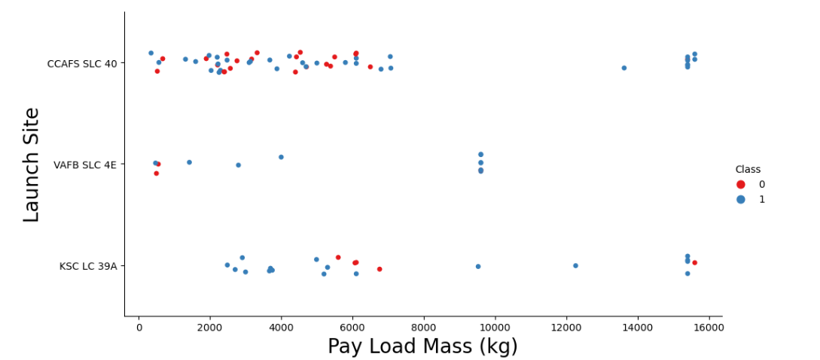
Launch Site & Payload Mass
CCAFS SLC 40 seems to have a smaller payload mass.
Higher payload mass seems to have a higher success launch rate.

Slide 22
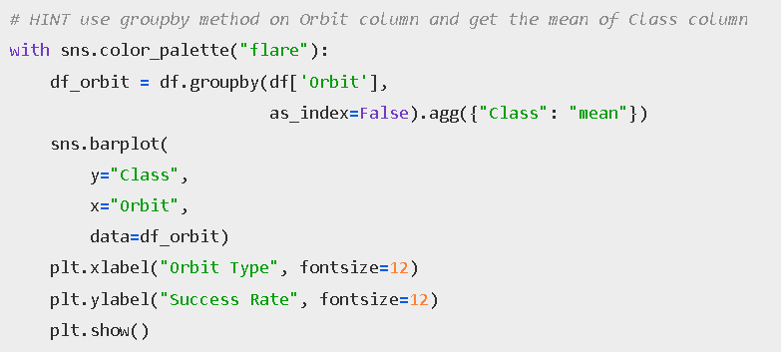
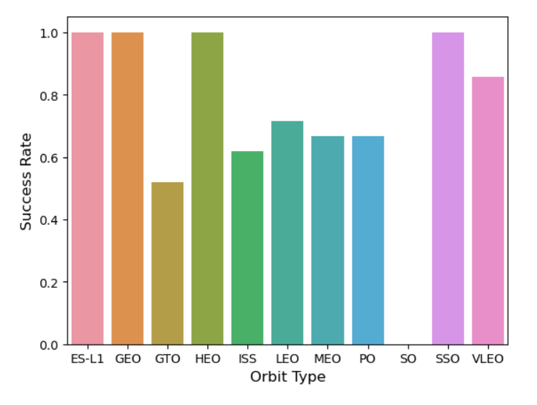
Orbit type & Class
We have 4 orbit types that seems to have a higher success launch rate: ES-L1, GEO, HEO, and SSO.

Slide 23
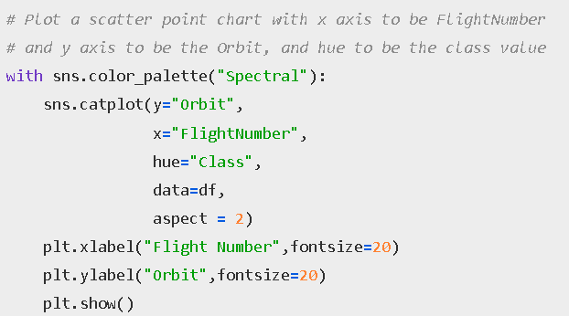
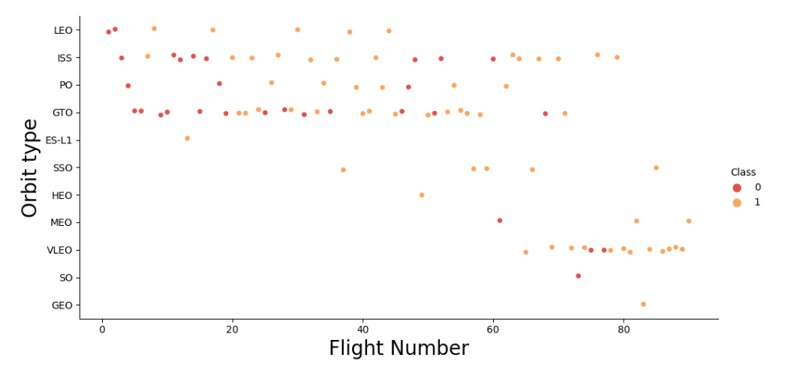
Orbit type & Flight Number
We can see that there is a higher amount of launching attempts for GEO,SO,VLEO, MEO, HEO, and SSO.

Slide 24
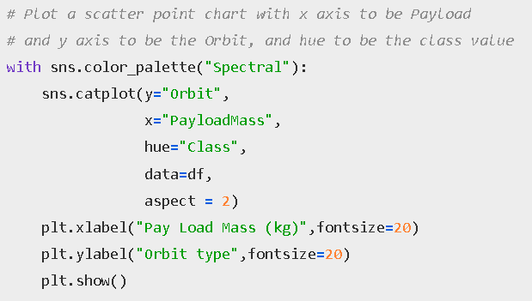
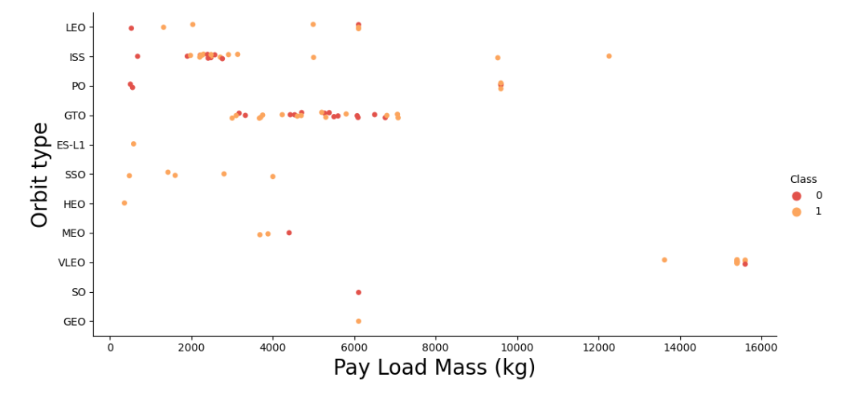
Orbit type & Payload Mass
Data seems to be more clattered around a lower payload mass.

Slide 25
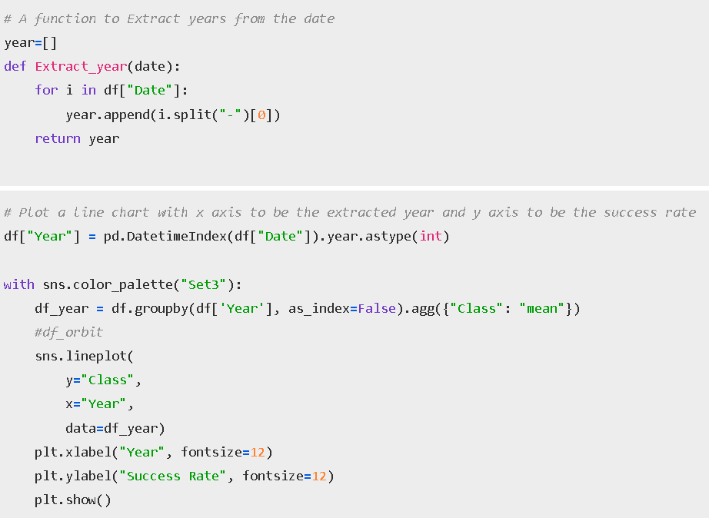
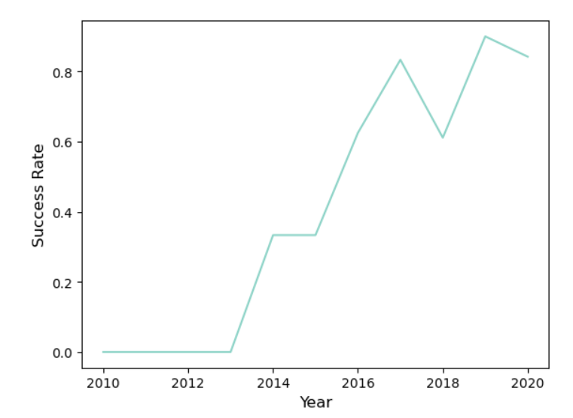
Success Rate per year
The rate of success seems to better along the years. There seems an increase on 2017 and 2019.

Slide 26

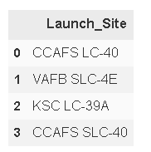


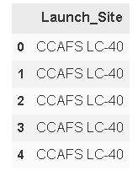
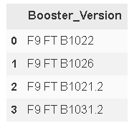
SQL
Task 3
The total payload mass carried by boosters launched by NASA (CRS) is 45596 kg.
Task 1
Task 4
We have 4 different launch sites.
The average payload mass carried by booster version F9 v1.1is 2928 kg.
Task 5
Task 2
The first successful landing was on 22 December 2015.
5 records where launch sites begin with the string 'CCA'
Task 6
The names of the boosters which have success in drone ship and have payload mass greater than 4000 but less than 6000.

Slide 27
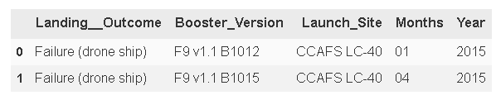
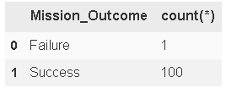
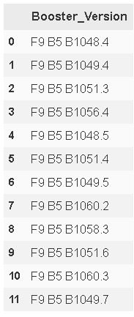
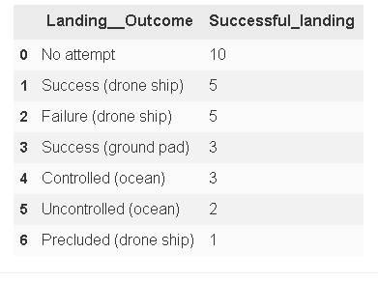
SQL
Task 9
Task 7
Failed landing outcomes in 2015 by drone ship.
We have one failure and 100 successful missions.
Task 8
Task 10
List of booster_versions which have carried the maximum payload mass
List of successful landing_outcomes between the date 04-06-2010 and 20-03-2017

Slide 28
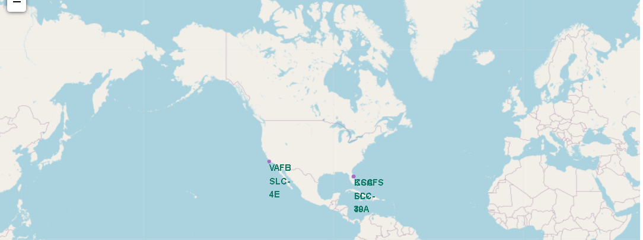
GLOBAL LAUNCH SITES FOR SPACEX
Launch sites seems to be situated in USA.
Launch sites are close to the coastline. Being close to the coastline will increase the security in case stage 1 will fail.

Slide 29
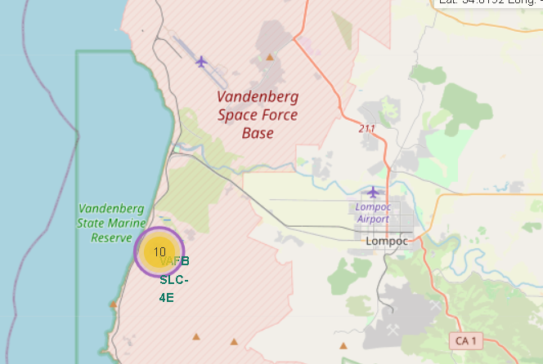
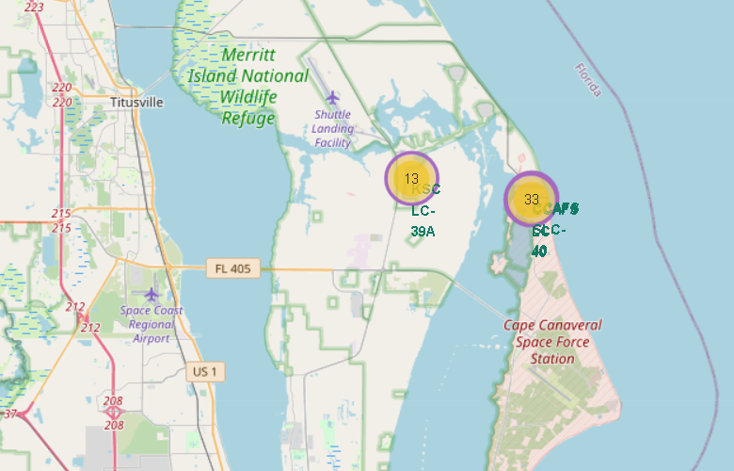
PROXIMITY OF THE LAUNCHING SITES
→Close to water & airports

Slide 30
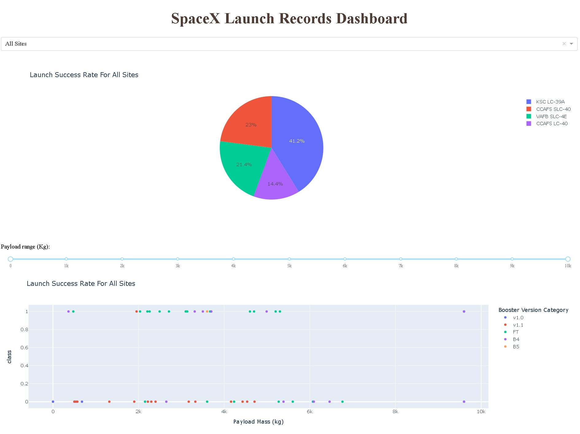
INTERACTIVE DASHBOARD
We can see the dashboard created via Dash.
We have 2 graphs and a payload range.
The dashboard is an interactive one so next we will be showing insights.

Slide 31
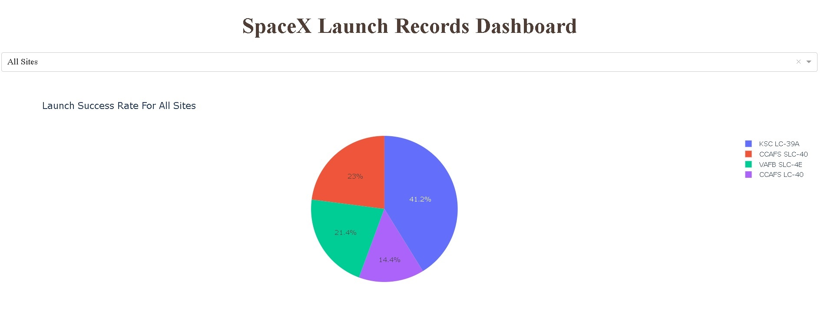
Which site has the largest successful launches? →KSC LC 39A

Slide 32
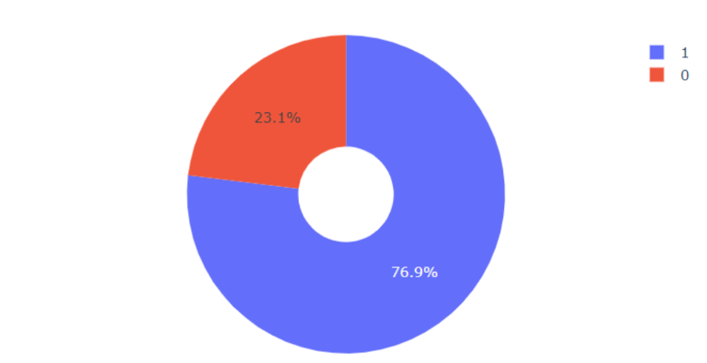
Which site has the highest launch success rate? →KSC LC 39A had a 76% success rate.

Slide 33
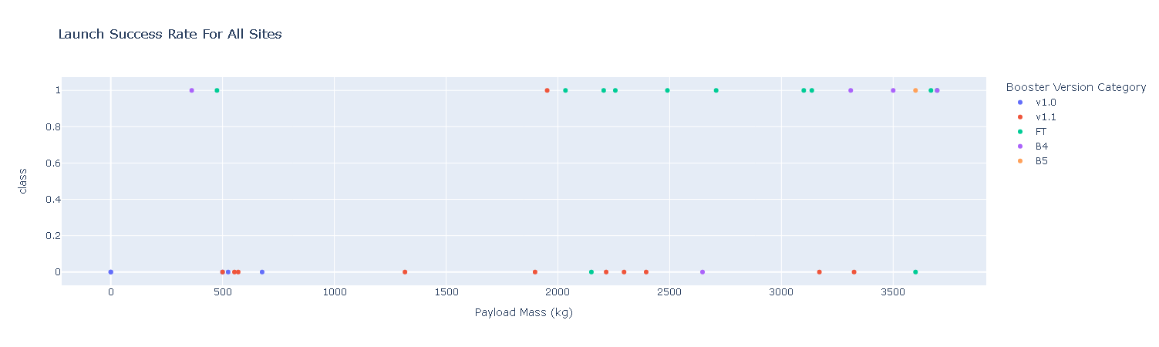
Which payload range(s) has the highest launch success rate? →Lower than 4000 kg

Slide 34
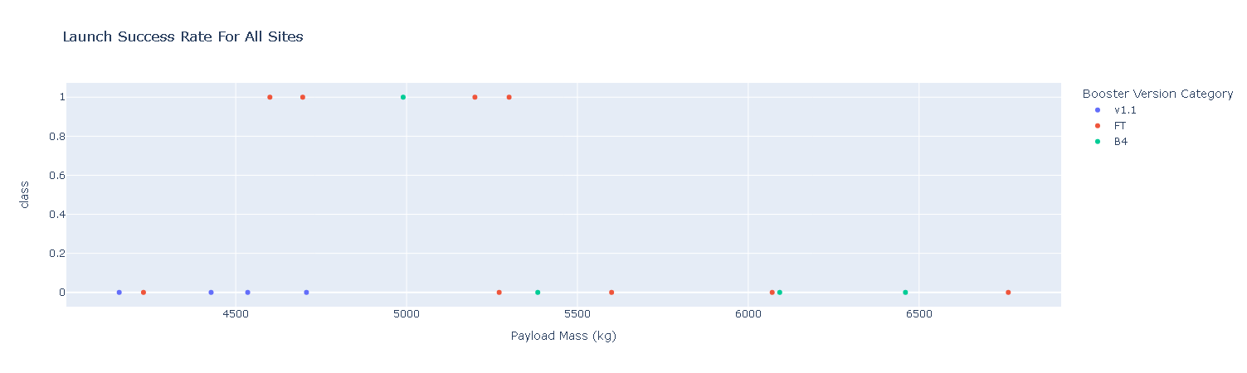
Which payload range(s) has the lowest launch success rate? →between 4000 and 7000 kg.

Slide 35
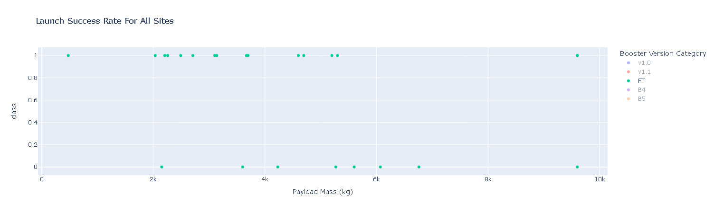
Which F9 Booster version has the highest launch success rate? →FT

Slide 36
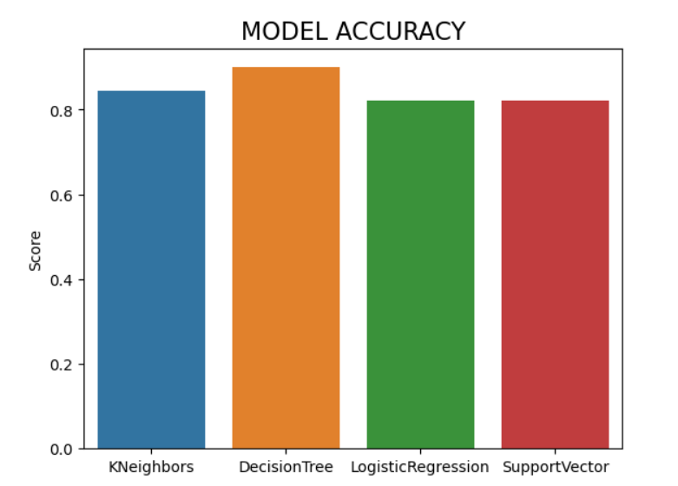
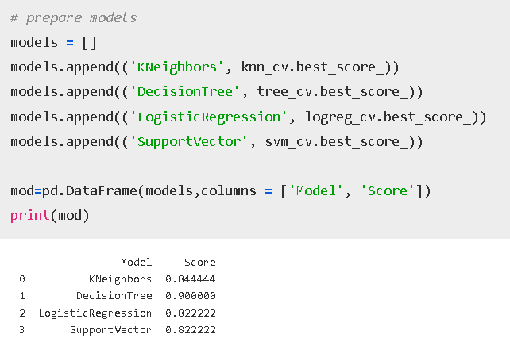
CLASSIFICATION ACCURACY
DecisionTree seems to have the highest score followed by Kneighbors.

Slide 37
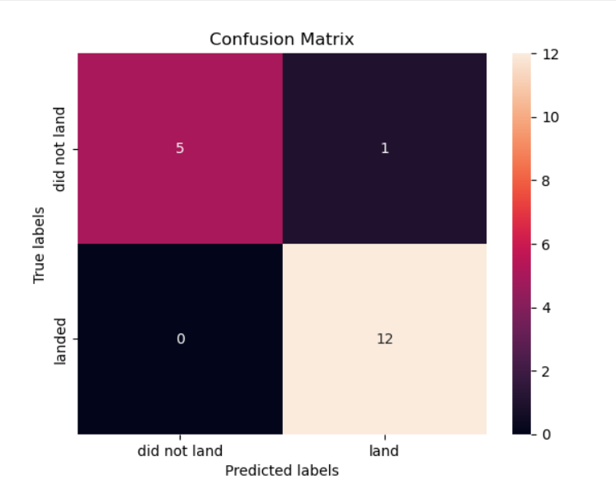
CONFUSION MATRIX
According to the Decision Tree Confusion Matrix:
The model predicted 0 false did not land.
The model predicted 12 positive did land.
The model predicted 5 positive did not land.
The model predicted 1 false did land.

Slide 38
CONCLUSIONS
01 | INSIGHTS
There was a spike on launch success rate in 2017 & 2019.
Orbits ES-L1, GEO, HEO, SSO, VLEO had the most success rate.
KSC LC-39A had the most successful launches of any sites.
Launching sites are located near coastlines.
02 | MODEL
The Decision tree classifier is the best machine learning algorithm for this task, followed by a KNN.
Decision tree classifier has an accuracy of 0,9.

Slide 39
THANK YOU!

